Slide 1

Chapter 28
Integrating Web Workers

Slide 2
Learning Objectives
How a Web worker is essentially a JavaScript routine that performs concurrent processing within the background
How to create and use a Web worker within an HTML page
How to start, stop, and terminate a Web worker
What the objects a Web worker can and cannot access

Slide 3
Understanding web workers
In general, to perform concurrent processing, an operating system quickly switches between tasks, giving the perception that multiple actions are occurring at the same time.
Given that today’s processors are often multicore, the operating system can assign each core processor a task to perform. Developers refer to such tasks as a thread of execution. Each thread contains the instructions the processor executes to accomplish a specific task.
A Web worker is a JavaScript routine that allows a webpage to perform similar concurrent processing. In general, a webpage uses a specific JavaScript file that contains the code the worker performs to accomplish a task.
The webpage that uses the worker creates a worker object, which begins to perform its processing within the background. As the worker completes its processing, it sends a message to the webpage. The webpage, in turn, can use the message as appropriate. The Web worker does not impact the webpage performance because it runs in the background.

Slide 4
Testing for Browser Web Worker Support
<!DOCTYPE html> <html> <head> <script> function testWorkerSupport() { if (typeof(Worker) != "undefined") alert("Web Workers Supported"); else alert("Web Workers Not Supported"); } </script> </head> <body onload="testWorkerSupport();"> </body> </html>
Notes:
Note: For security reasons, you cannot run a Web page that uses a Web worker from a file:// connection. You must upload your HTML file and JavaScript file to a Web server. To run the examples presented in this chapter, see the Try It section at the end of the chapter, which lets you run the files from the book’s companion website.

Slide 5
Creating a Web Worker Script
A Web worker is essentially a JavaScript routine that performs specific processing as a background task.
A background task is a thread of execution the processor executes during its “free time” or using an available core processor.
The following JavaScript file, Time.js, defines a function that wakes up every second to determine the current time. The code then uses the postMessage function to send the time back to the webpage that is using the worker:
function myTimer() { var date = new Date(); vartimeStr = date.toLocaleTimeString(); postMessage(timeStr); setTimeout(myTimer,1000); } setTimeout(myTimer,1000);

Slide 6
Using the Web Worker
<!DOCTYPE html> <html> <head> <script> var worker;
function startWorker() { if (typeof(Worker) != "undefined") { worker = new Worker("time.js"); worker.onmessage = function(event) { showTime(event); }; } else alert("Web Workers Not Supported"); } function showTime(event) { document.getElementById('clock').innerHTML = event.data; }

Slide 7
Continued
function StopWorker() { if (worker) { worker.terminate(); worker = null; } }
function StartWorker() { if (! worker) startWorker(); }
</script> </head> <body onload="startWorker();"> <div id="clock" style="font-size:100px"></div> <img src="hourglass.jpg"> <br/> <button onclick="StopWorker()">Stop Worker</button> <button onclick="StartWorker()">Start Worker</button> </body> </html>

Slide 8
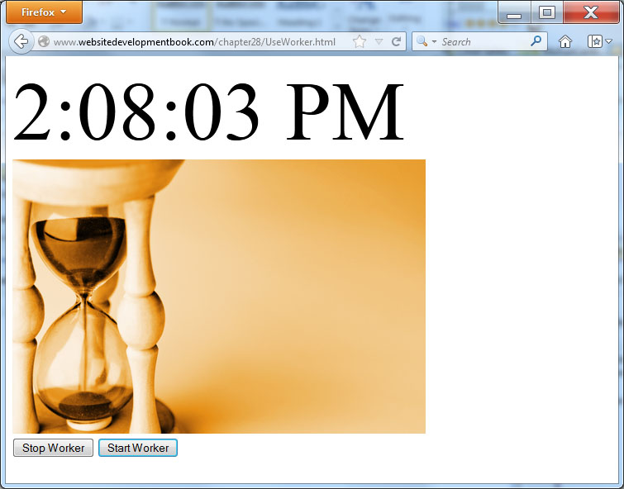
result

Slide 9
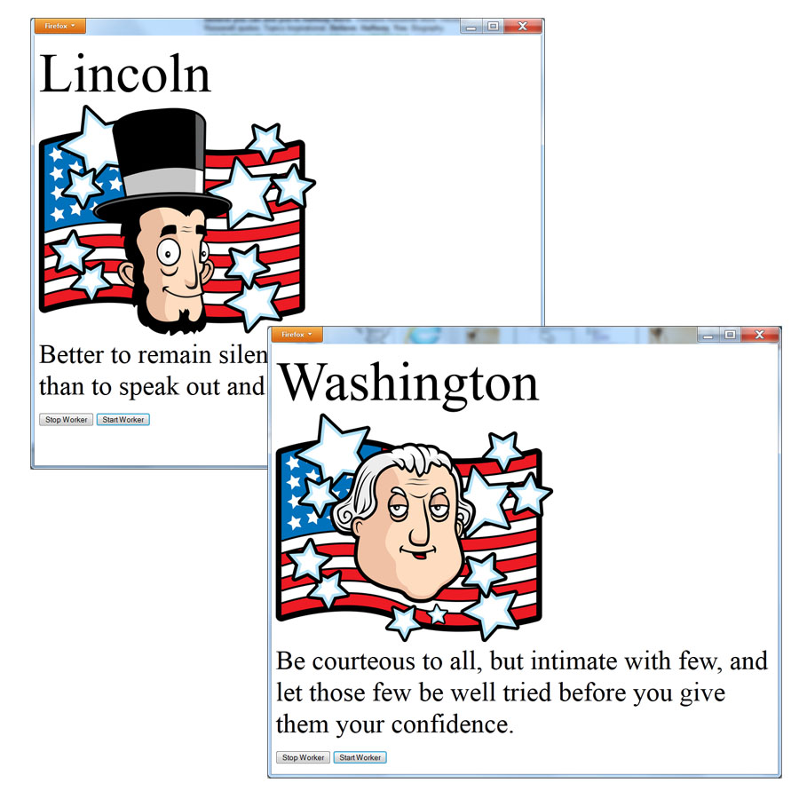
Looking at a Second Example
The following HTML file, FamousQuotes.html, displays a photo, a name, and a quote. Every 10 seconds, the file changes its content based on the worker input.

Slide 10
Quotes.js worker file
var index = 0; var quotes = new Array('Lincoln; Lincoln.jpg; Better to remain silent and be thought a fool than to speak out and remove all doubt.', 'Einstein; Einstein.jpg; A person who never made a mistake never tried anything new.', 'Washington; Washington.jpg; Be courteous to all, but intimate with few, and let those few be well tried before you give them your confidence.'); function myTimer() { postMessage(quotes[index]); index += 1; if (index == 3) index = 0; setTimeout(myTimer,10000); } setTimeout(myTimer,500);
Notes:
As you can see, the script uses an array of character strings that define the person’s name, a corresponding image file, and a quote. Every ten seconds the timer triggers, which causes the function to send the next quote data. The script continues to repeat through the array elements.

Slide 11
Famousquotes.html
<!DOCTYPE html> <html> <head> <script> var worker; function startWorker() { if (typeof(Worker) != "undefined") { worker = new Worker("Quotes.js"); worker.onmessage = function(event) { showQuote(event); }; } else alert("Web Workers Not Supported"); } function showQuote(event) { var name = event.data.substring(0, event.data.indexOf(';')); document.getElementById('name').innerHTML = name; varimagefile = event.data.substring(event.data.indexOf(';')+1, event.data.lastIndexOf(';')); document.getElementById('photo').src = imagefile; var quote = event.data.substring(event.data.lastIndexOf(';')+1); document.getElementById('quote').innerHTML = quote; }

Slide 12
continued
function StopWorker() { if (worker) { worker.terminate(); worker = null; } } function StartWorker() { if (! worker) startWorker(); } </script> </head> <body onload="startWorker();"> <div id="name" style="font-size:100px"></div> <img id="photo" src="lincoln.jpg"> <div id="quote" style="font-size:48px"></div> <br/> <button onclick="StopWorker()">Stop Worker</button> <button onclick="StartWorker()">Start Worker</button> </body> </html>

Slide 13
Objects a web worker can and can’t access
Web workers are meant to perform complex processing within the background. Web workers cannot access the following objects because they reside in an external JavaScript file,:
window object
document object
parent object
localStorage or sessionStorage
Web workers can, however, access the following:
location object
navigation object
application cache
XMLHTTPRequest

Slide 14
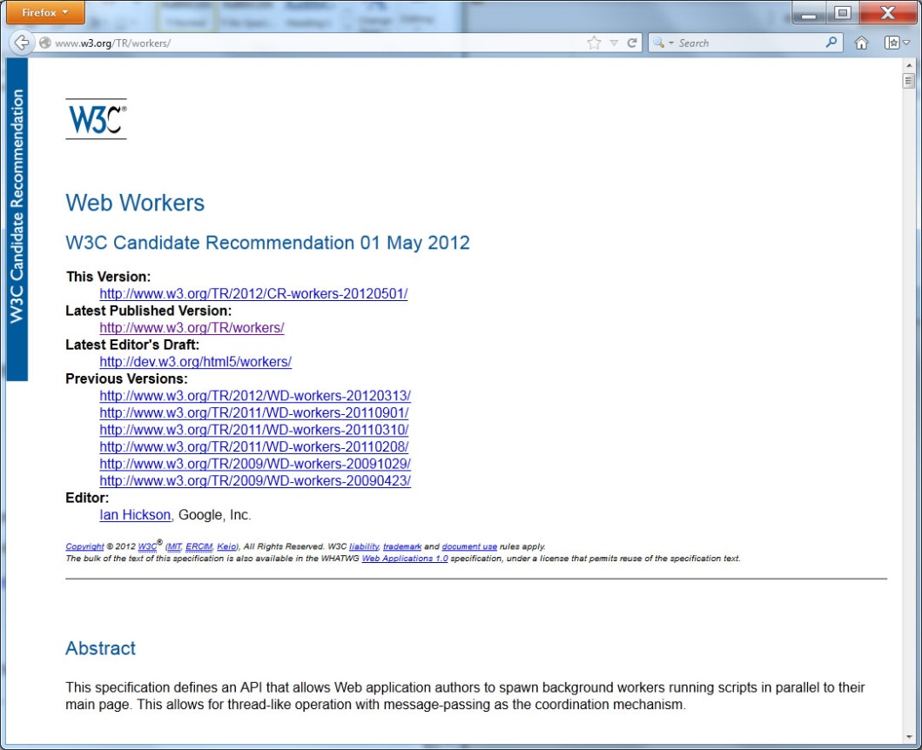
Real world design – web worker specification

Slide 15
summary
With many computers now using multicore processors, the use of threads to implement concurrent processing is becoming quite common.
In this chapter, you learn how to use Web workers to perform background processing for a webpage.
As you learned, a Web worker is essentially a JavaScript routine that performs specific processing.
Because the Web worker performs its processing in the background, the worker does not impact the webpage performance.

